Slide 1
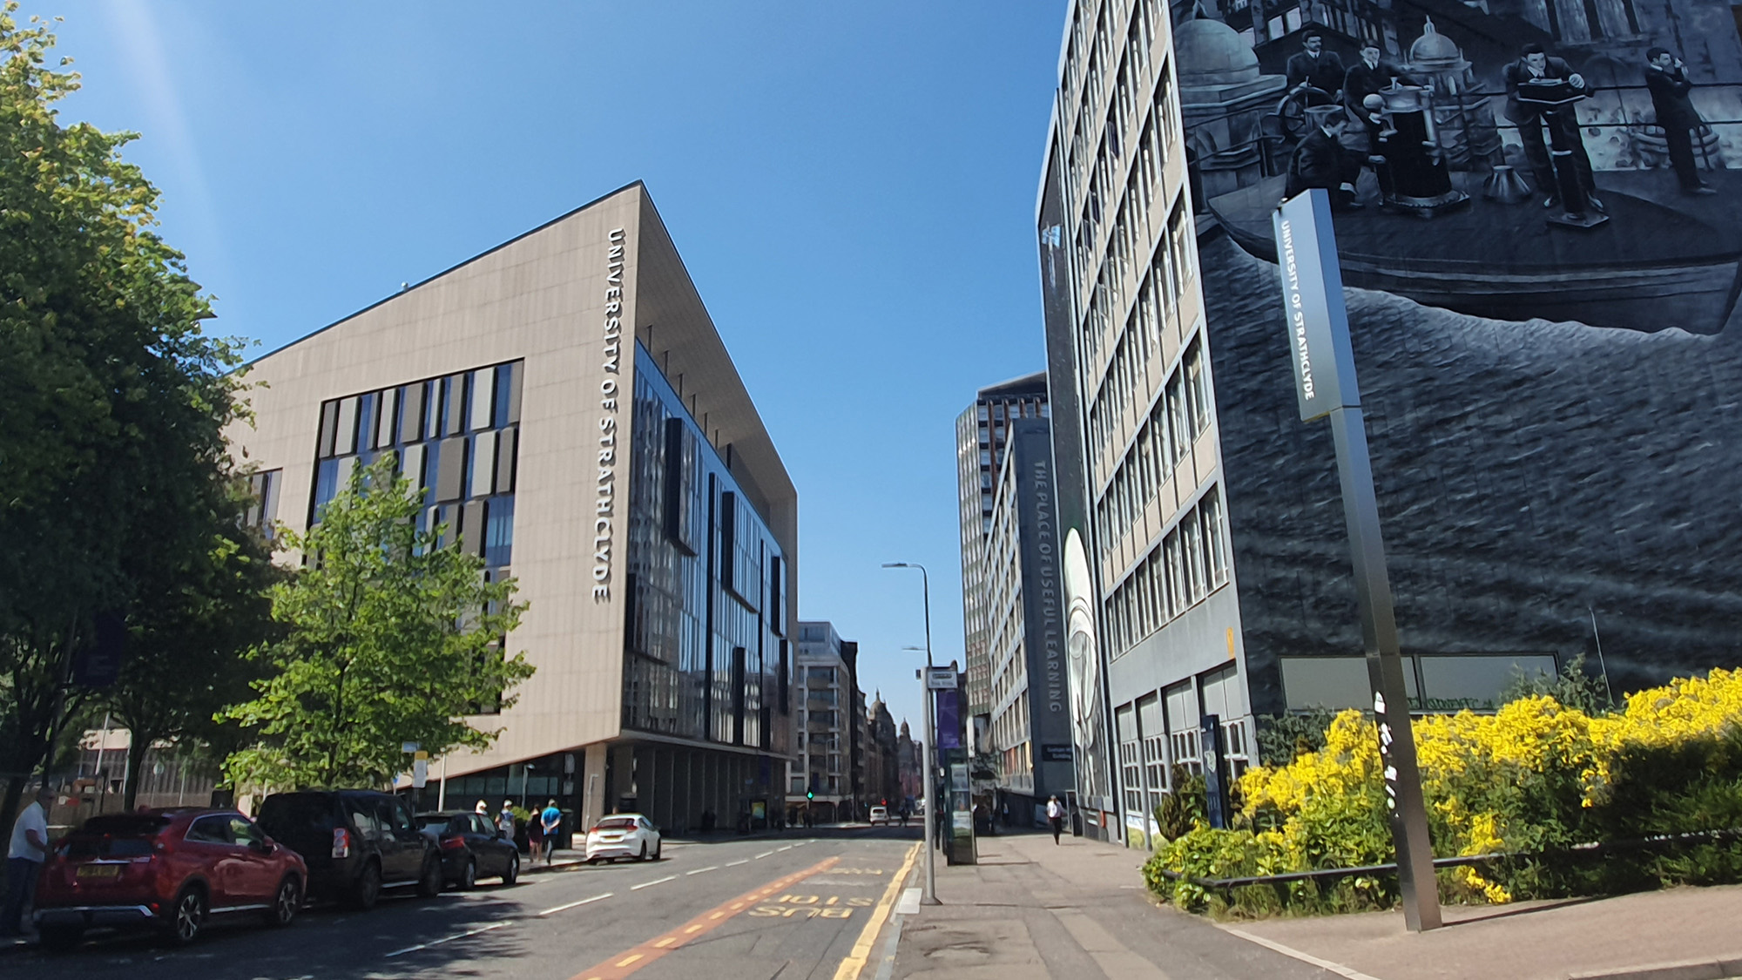

Digital filters
Digital Filters Design: Pole Zero Placement
carmine.clemente@strath.ac.uk

Slide 2
Introduction
At the discrete LTI analysis stage we have learned how to derive the frequency response of a system from its Zero-Pole diagram;
A zero will cause a zero of the magnitude response in the corresponding point, while a pole will cause a peak;
The closer the poles to the unit circle are the higher is the peak, while closer is the zero to the unit circle the sharper is the decrease of magnitude;

Slide 3

Introduction
We can use our knowledge to strategically decide where to put poles and zeros and design our desired magnitude response of a digital filter!

Slide 4
Zero Pole placement: design consideration
Remember: in order to have real valued coefficients for our filter we need to have real poles and zeros or occurring in complex conjugate pairs.
Im(z)
z-plane
o
o
x
x
x
Real(z)
o
o

Slide 5
Zero Pole placement: Example 1
Let’s design a filter using zero-pole placement and derive its difference equation using the following specifications:
Complete signal rejection at dc and 250Hz
A narrow passband centered at 125Hz
A 3 dB bandwidth of 10 Hz;
The filter should operate on signal sampled at a sampling frequency of 500 Hz;

Slide 6
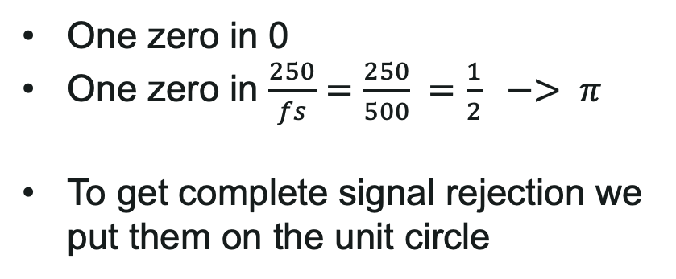

Zero Pole placement: Example 1
Complete signal rejection at dc and 250Hz
One zero in 0
One zero in $\frac{250}{fs}=\frac{250}{500} =\frac{1}{2} −> π$
To get complete signal rejection we put them on the unit circle
Im(z)
z-plane
o
o
$$π$$
Real(z)

Slide 7
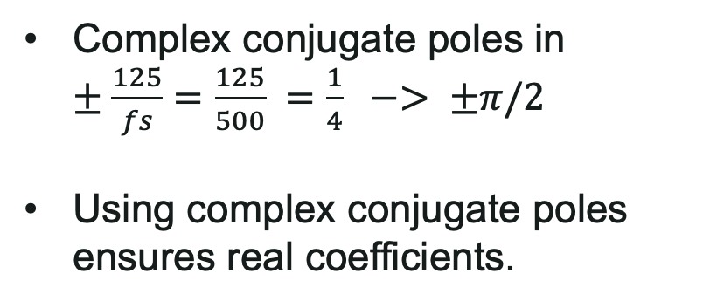
Zero Pole placement: Example 1
A narrow passband centered at 125Hz
Complex conjugate poles in $±\frac{125}{fs}=\frac{125}{500} =\frac{1}{4} −> ±π/2$
Using complex conjugate poles ensures real coefficients.
Im(z)
z-plane
x
o
o
$$π$$
Real(z)
x

Slide 8




Zero Pole placement: Example 1
A 3 dB bandwidth of 10 Hz;
Im(z)
z-plane
The radius $r$ is determined by the desired bandwidth.
An approximate approximation between $r$ and bandwidth$\left(bw\right)$for $r>0.9$is given by:
$$r≈ 1−\left(\frac{bw}{fs}\right)π$$
In our case $r = 1 –\left(\frac{10}{500}\right)π = 0.937;$
x
$$r$$
o
o
$$π$$
$$r$$
Real(z)
x

Slide 9


Zero Pole placement: Example 1
By inspection we can now write the system function $H(z)$
Im(z)
z-plane
x
$$0.937$$
o
o
$$π$$
Real(z)
x

Slide 10
Zero Pole placement: Example 1
And from $H(z)$ we can get the linear difference equation
$$y[n] = −0.877969 y[n−2] +x[n] –x[n−2]$$

Slide 11

Zero Pole placement: Example 2
Let’s design a filter using zero-pole placement to obtain the coefficients of a notch filter with the following specifications:
Notch frequency 50Hz;
3 dB width of notch $±$5Hz;
Sampling frequency 500 Hz;

Slide 12
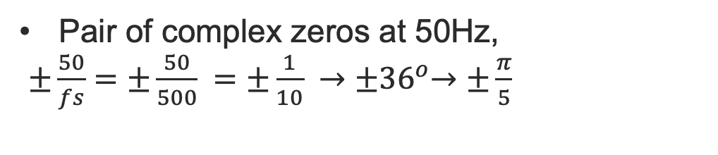
Zero Pole placement: Example 2
Notch frequency 50Hz
Pair of complex zeros at 50Hz,
$±\frac{50}{fs}=±\frac{50}{500} =±\frac{1}{10} →{±36}^{o}→±\frac{π}{5}$
Im(z)
z-plane
o
$$π$$
o
Real(z)

Slide 13


Zero Pole placement: Example 2
3 dB width of notch $±$5Hz;
To achieve this we can put a pair of complex conjugate poles at the same frequency but with radius. $r<1$
The width of the notch is determined by the location of the poles
As in the previous example
we are looking for a 10 Hz bandwidth, thus $r=0.9372$
Im(z)
z-plane
o
x
$$0.937$$
$$π$$
x
Real(z)
o

Slide 14

Zero Pole placement: Example 2
By inspection we can now write the system function
Im(z)
z-plane
o
x
$$0.937$$
$$π$$
x
Real(z)
o
0

Slide 15
Zero Pole placement: Example 2
0
And we can get the linear difference equation of the filter as:
$$y[n] = x[n] −1.6180x[n−1] +x[n−2] +1.5164y[n−1]−0.8783y[n−2]$$

